Slide 1
Deep Dive of the SharePoint Framework
Tools: SharePoint Yeoman Generator, Gulp, and Workbench

Slide 2
Agenda
SharePoint Yeoman Generator
Gulp
SharePoint Workbench
Q&A

Slide 3
SharePoint Framework – All about typical web stack tooling

Slide 4
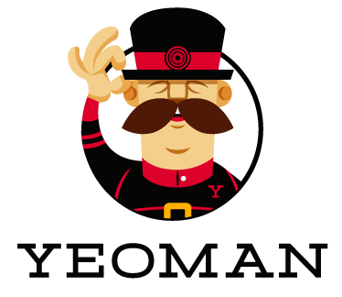
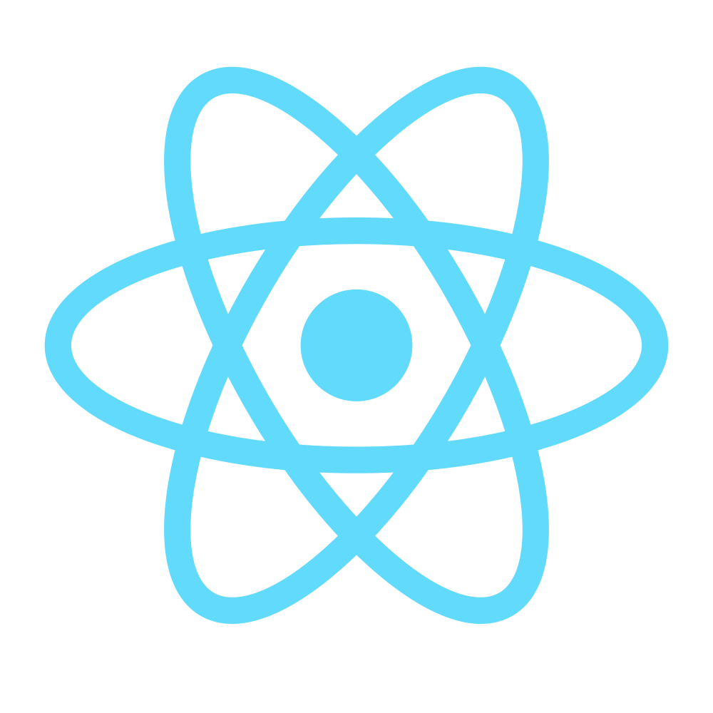

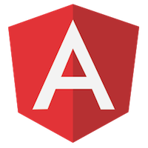
Typical tooling for SharePoint Framework
Tooling
Node.js
Yeoman
Gulp
TypeScript
Visual Studio (Code)
Frameworks – Choose yours
React
Angular.js
Knockout
Etc.
Notes:
SharePoint will also support open source tooling to drive greater efficiencies when developing Parts and Apps. These tools should not be considered a replacement of an organizations traditional tools, but rather an extension of those, providing new opportunities to quickly get up and running with SharePoint development. If you’re familiar with Visual Studio development with SharePoint, this tools carry a lot of similarities with the tools you may already be familiar with for example:
Yeoman provides a generator ecosystem. A generator is basically a plugin that can be run with the `yo` command to scaffold complete projects or useful parts.
yo scaffolds out a new application, writing your build configuration (e.g Gruntfile, Gulpfile) and pulling in relevant build tasks and package manager dependencies (Bower, npm) that you might need for your build. This is similar to Project Scaffolding in Visual Studio.
Gulp
Automation - gulp is a toolkit that helps you automate painful or time-consuming tasks in your development workflow.
Platform-agnostic - Integrations are built into all major IDEs and people are using gulp with PHP, .NET, Node.js, Java, and other platforms.
Strong Ecosystem - Use npm modules to do anything you want + over 2000 curated plugins for streaming file transformations
Simple - By providing only a minimal API surface, gulp is easy to learn and simple to use
Node.js® is a JavaScript runtime built on Chrome's V8 JavaScript engine. Node.js uses an event-driven, non-blocking I/O model that makes it lightweight and efficient. Node.js' package ecosystem, npm, is the largest ecosystem of open source libraries in the world.
event driven JavaScript runtime, Node is designed to build scalable network applications similar to
VS SharePoint development: Gulp = MSBuild, NodeJS = IIS (Express), YeoMan = project scafolding in VS, TypeScript= typed superset of JavaScript

Slide 5



Web stack tooling compared to classic MS tools
IIS Express
MS Build
VS Project →
New → <Template>
C#

Slide 6
Open Source Tooling Support
Power Apps for rapid creation of business applications built on SharePoint data
Office UI Fabric
Make all of the tools and technologies that internal engineers use to build available to third party developers
Source open repos for apps
Notes:
SharePoint will also support open source tooling to drive greater efficiencies when developing Parts and Apps. These tools should not be considered a replacement of an organizations traditional tools, but rather an extension of those, providing new opportunities to quickly get up and running with SharePoint development. If you’re familiar with Visual Studio development with SharePoint, this tools carry a lot of similarities with the tools you may already be familiar with for example:
Yeoman provides a generator ecosystem. A generator is basically a plugin that can be run with the `yo` command to scaffold complete projects or useful parts.
yo scaffolds out a new application, writing your build configuration (e.g Gruntfile, Gulpfile) and pulling in relevant build tasks and package manager dependencies (Bower, npm) that you might need for your build. This is similar to Project Scaffolding in Visual Studio.
Gulp
Automation - gulp is a toolkit that helps you automate painful or time-consuming tasks in your development workflow.
Platform-agnostic - Integrations are built into all major IDEs and people are using gulp with PHP, .NET, Node.js, Java, and other platforms.
Strong Ecosystem - Use npm modules to do anything you want + over 2000 curated plugins for streaming file transformations
Simple - By providing only a minimal API surface, gulp is easy to learn and simple to use
Node.js® is a JavaScript runtime built on Chrome's V8 JavaScript engine. Node.js uses an event-driven, non-blocking I/O model that makes it lightweight and efficient. Node.js' package ecosystem, npm, is the largest ecosystem of open source libraries in the world.
event driven JavaScript runtime, Node is designed to build scalable network applications similar to
VS SharePoint development: Gulp = MSBuild, NodeJS = IIS (Express), YeoMan = project scafolding in VS, TypeScript= typed superset of JavaScript

Slide 7
Node.js – Development time hosting
https://nodejs.org/en/
Development-time hosting platform
Local JavaScript runtime environment
Can be considered as the IIS Express in typical Microsoft stack
Can also work as backend system with server-side code, if needed

Slide 8
Yeoman - Templates
> yo sharepoint
http://yeoman.io
Scaffolding tool for development projects
Used to deliver SharePoint Framework templates to your development machine
Installed to your machine using npm
Creates new projects, updates existing projects, adds web parts to existing projects

Slide 9
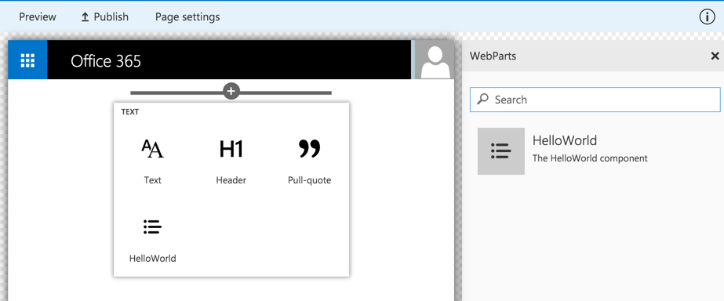
Client-side Web Part Build Flow
npm install @Microsoft/generator-sharepoint -g
gulp serve
gulp package-solution
Install SharePoint Generator
Test
Package/Deploy
yo sharepoint
workbench
gulp deploy-azure-storage
Scaffold SharePoint Web Part Project
Local
Package/Deploy
Code .
manual upload of the app
Build Web Part Code
UAT / Pre-production
Release using app catalog*
Ship?
Available on Classic and Client-Side Pages

Slide 10
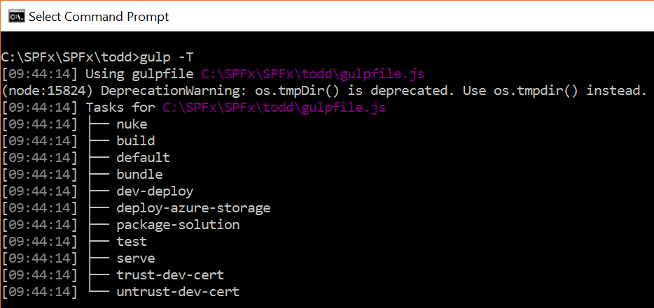
Gulp Tasks
Defined and implemented in @microsoft\sp-build-core-tasks npm package
List the available Gulp tasks
> gulp -T

Slide 11
What the Gulp tasks do
nuke - deletes SharePoint Framework build folders and intermediate Sass files in the src folder
build - build the project
default - equivalent to bundle
bundle - build, localize, and bundle the project
dev-deploy - deploy the current project to a development Azure CDN for sharing builds with colleagues
deploy-azure-storage - upload the assets to a development CDN
package-solution - package the project into a SPAPP
test - build, localize, and bundle the project and run tests, and verify the coverage
serve - build and bundle the project and run the development server
trust-dev-cert - generates and trusts a development certificate if one isn't already present
untrust-dev-cert - untrusts and deletes the development certificate if it exists

Slide 12
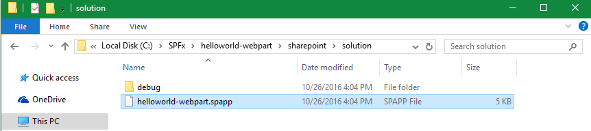
Solution Packaging
Gulp tasks packages solution
Package contents are put into an .spapp file
The JavaScript files, CSS and other assets are not packaged, they must be deployed to an external location such as a CDN.
> gulp –package-solution
Notes:
The package uses a SharePoint Feature to package your web part. By default, the gulp task creates the following:
1. A feature for your web part.
2. A .webpart file for your web part, which is an XML file that describes the web part.
You can view the raw package contents in the sharepoint folder.
The contents are then packaged into a .spapp file. The package format is very similar to a SharePoint Add-in package and uses the Microsoft Open Packaging Conventions to package your solution.
The JavaScript files, CSS and other assets are not packaged and you will have to deploy them to an external location such as a CDN. In order to test the web part during development, you can load all the assets from your local computer.

Slide 13
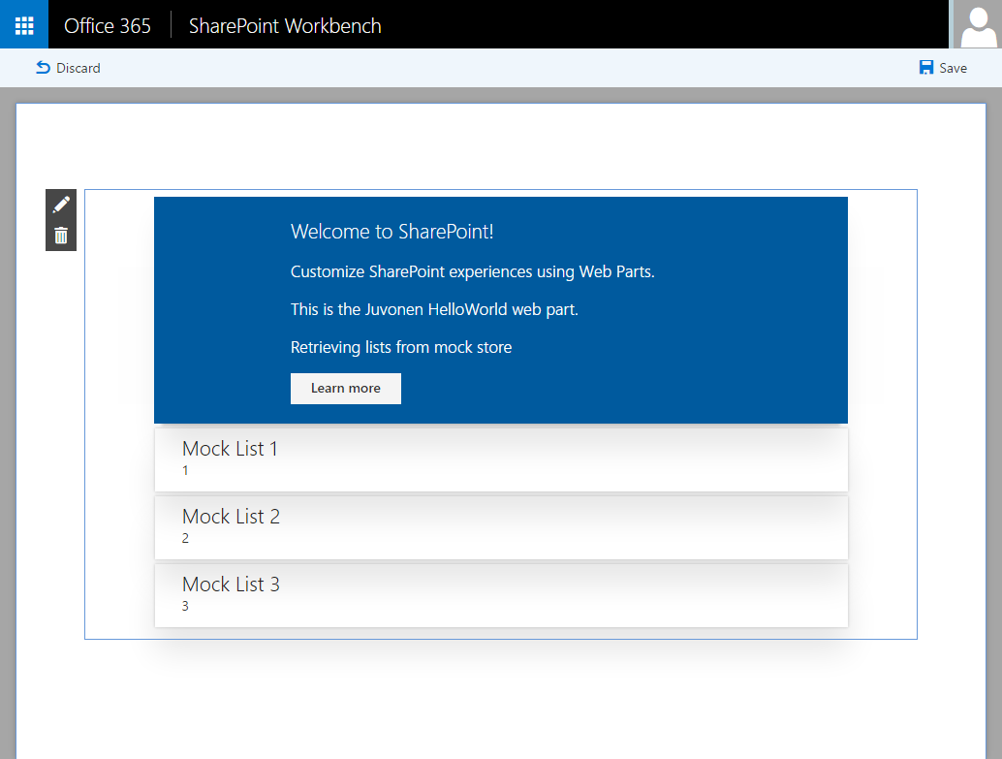
SharePoint Workbench
Local development time experience
Test your changes immediately even in offline mode

Slide 14
Debugging
Build and run on local server and automatically launch local SharePoint Workbench
Build and run solution on local server
> gulp serve
> gulp serve --nobrowser

Slide 15

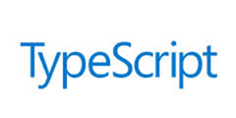
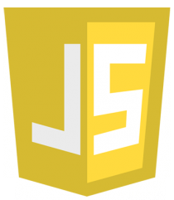
Mapping Files Making Debugging Easier
SPFx web parts are authored in TypeScript
The build process changes the TypeScript into JavaScript and bundles it all into a single file
As a result, it can be hard to debug the JavaScript the build generates
Source code mapping files make it possible to debug the original unbundled TypeScript code

Slide 16
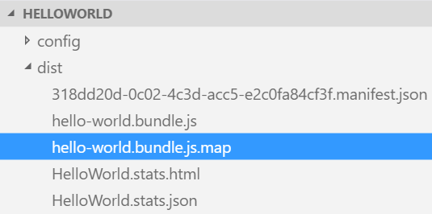
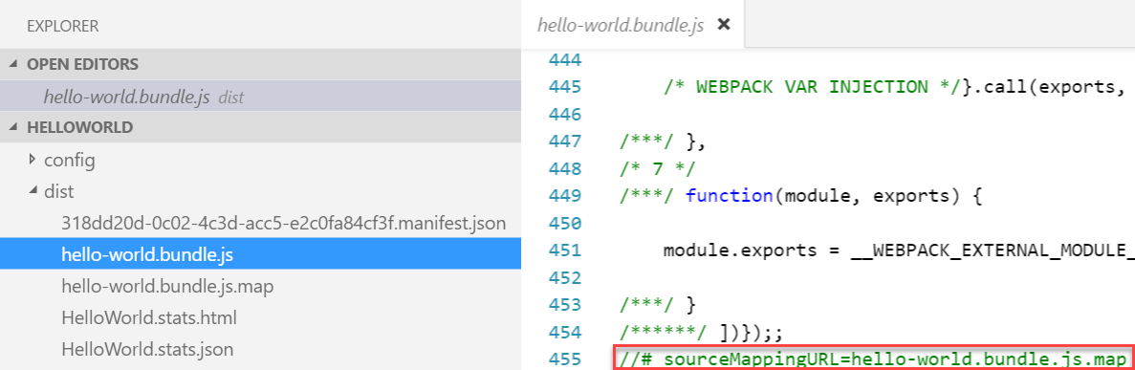
Source Code Mapping Files Details
SPFx generates source code mapping files in debug builds
TypeScript files are mapped to the generated JavaScript files
Source code mapping files are included in the generated JavaScript files

Slide 17
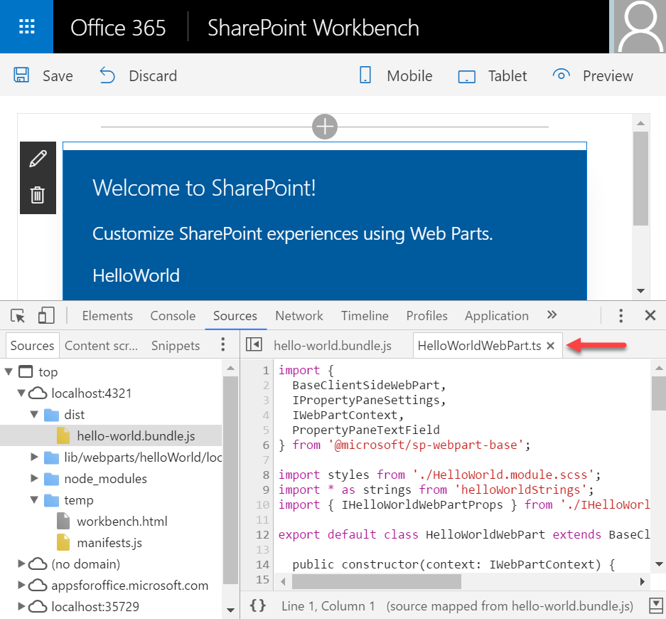
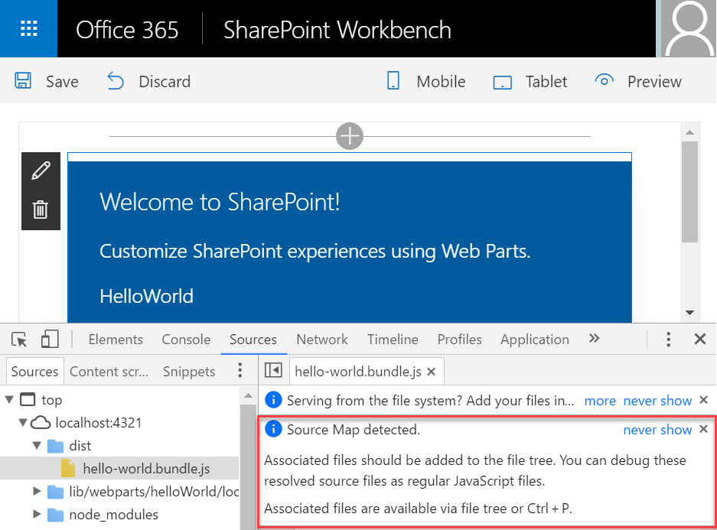
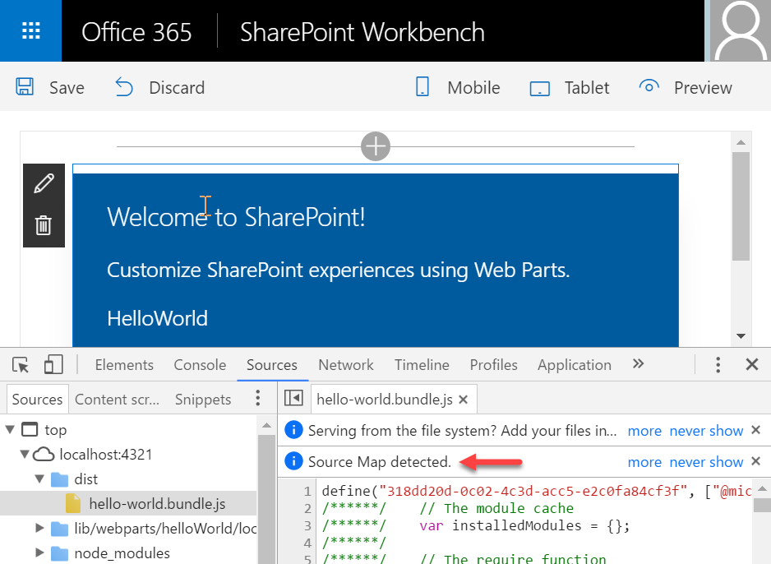
Debugging a debug build

Slide 18
Local Workbench vs. SharePoint Workbench
Local
Runs on https://localhost
Has no SharePoint Context
Use mock data
SharePoint
Runs on SharePoint Site (https://<TENANT>.sharepoint.com/sites/dev/Shared%20Documents/workbench.aspx)
Upload workbench.aspx to the Document Library
Has SharePoint Context
Use SharePoint data

Slide 19
DEMO
Package the HelloWorld web part
Deploy the HelloWorld package to the App Catalog
Install the client-side solution on your team site for the demo
Notes:
Use the Package the HelloWorld web part, Deploy the HelloWorld package to the App Catalog, and the Install the client-side solution on your team site exercises in the lab manual.

Slide 20
Summary
SharePoint Yeoman Generator
Gulp
SharePoint Workbench
Q&A

Slide 21
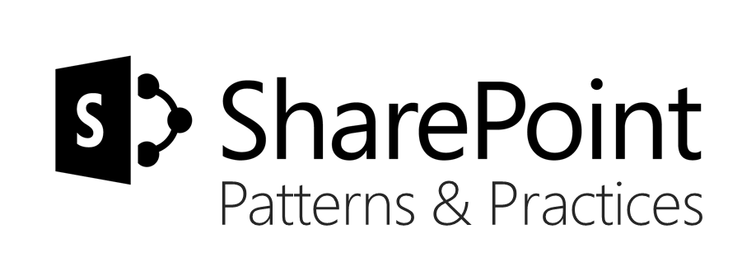
Sharing is caring…
Code samples and solutions
Reusable components
Guidance documentation
Monthly community calls
SharePoint Framework
SharePoint add-ins
Microsoft Graph
Office 365 APIs
http://aka.ms/SharePointPnP

Slide 22

Q&A

Slide 23


